Slide 1
NAME AND ADDRESS CONVERSIONS

Slide 2
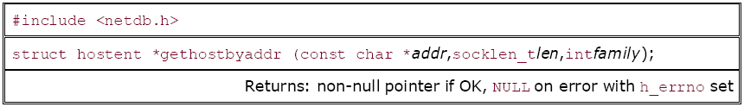
Name and Address Conversions
gethostbyname()
The gethostbyname() function returns a structure of type hostent for the given host name.
#include <netdb.h>
struct hostent *gethostbyname(const char *name);
gethostbyaddr()
The function gethostbyaddr takes a binary IPv4 address and tries to find the hostname corresponding to the address.
This function returns a pointer to the same hostent structure that was described with gethostbyname.

Slide 3
Hostent Structure Definition
The hostent structure is defined in <netdb.h> as follows
struct hostent
{
char *h_name; /* Official name of a host */
char **h_aliases; /* alias List */
int h_addrtype; /* host address type */
int h_length; /*length of address*/
char **h_addr_list; /* list of addresses */}
}
To access the h_addr_list ,first we store it in_addr structure.
{struct in_addr {
in_addr_t s_addr /* 32-bit IP address */
}; /* network byte ordered */

Slide 4
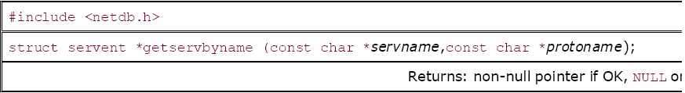
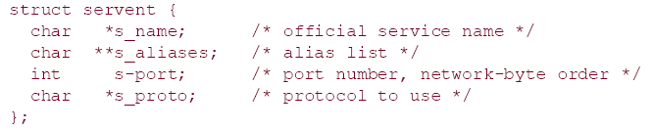
Contd…
getservbyname()
Services, like hosts, are often known by names.
The mapping from the name to port number is contained in a file (/etc/services)

Slide 5
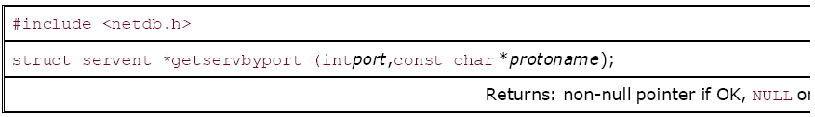
Contd…
getservbyport()
getservbyport, looks up a service given its port number and an optional protocol.

Slide 6
Byte Ordering Functions
Consider a 16-bit integer that is made up of 2 bytes.
There are two ways to store the two bytes in memory:
with the low-order byte at the starting address, known as little-endian byte order,
or with the high-order byte at the starting address, known as big-endian byte order (Network Byte Order).

Slide 7
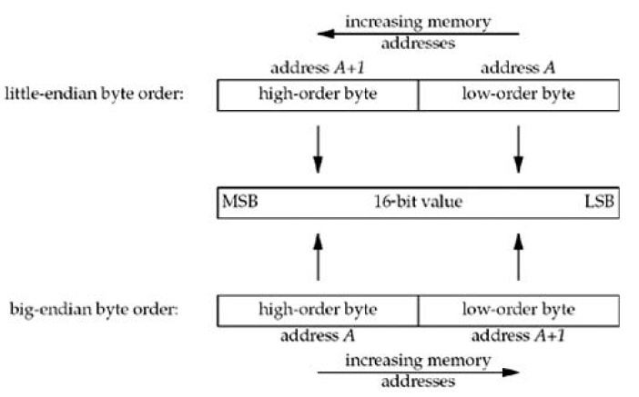

Slide 8
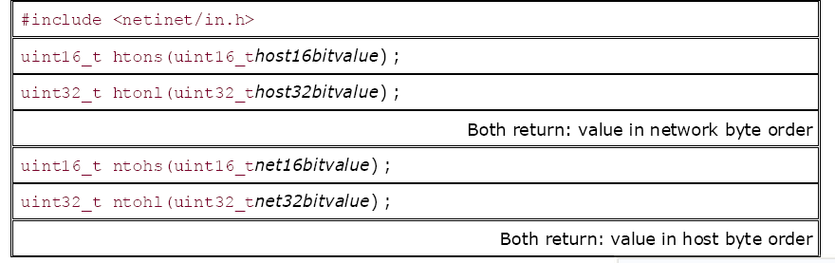
When using these functions, we do not care about the actual values (big-endian or little-endian) for the host byte order and the network byte order. What we must do is call the appropriate function to convert a given value between the host and network byte order.
On those systems that have the same byte ordering as the Internet protocols (big-endian), these four functions are usually defined as null macros.

Slide 9
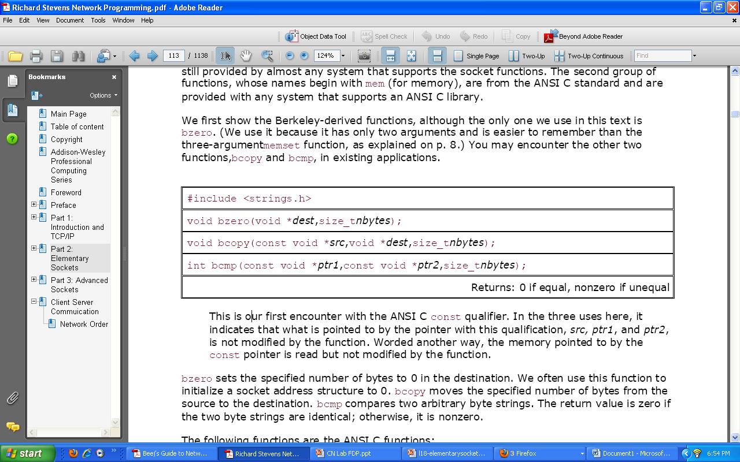
Byte Manipulation Functions
Functions that operate on multibyte fields, without interpreting the data, and without assuming that the data is a null-terminated C string.

Slide 10
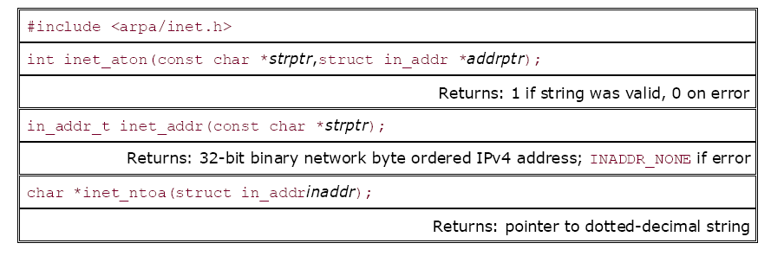
inet_aton, inet_addr, and inet_ntoa Functions
The address conversion functions convert Internet addresses between ASCII strings and network byte ordered binary values.
inet_aton, inet_ntoa, and inet_addr convert an IPv4 address from a dotted-decimal string (e.g., "206.168.112.96") to its 32-bit network byte ordered binary value.

